Slide 1


GIS
for Information Technology
Prepared by Information Technology Services Division-Office of Geospatial Information
– 2014
Notes:
GIS – Geographic Information System – Presented by Information Technology Services Division, Office of Geospatial Information

Slide 2

Location Location LOCATION!
An estimated 80% of all data collected contains information describing location.
You are here.
Notes:
Being able to analyze data in a geographic context is the main reason to use GIS software. Knowing where something is located in relationship to other locations gives us context for how things fit together in the world.

Slide 3
G – I –What?
Geography helps answer the question “Where is?”
You already recognize that some data is location based, without using the term ‘geographic analysis’
GIS is the underlying technology of cartography, web maps and mobile apps featuring maps
Have you ever used a GPS? Gone GeoCaching?
Notes:
GIS as a technology has been around as long as there have been computers, but geographic analysis and mapping dates back to ancient times. What do you know about GIS? Have you ever heard of it, or seen it used? You something think of your data in this way without thinking “Geography”. Even summarizing your data by county is a form of geographic analysis.

Slide 4
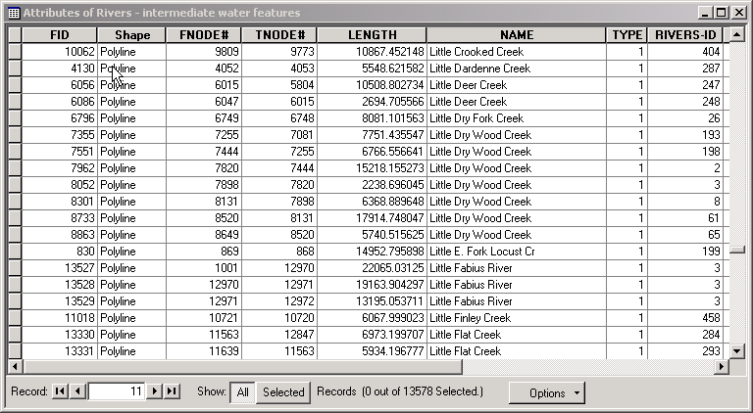
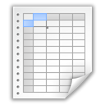
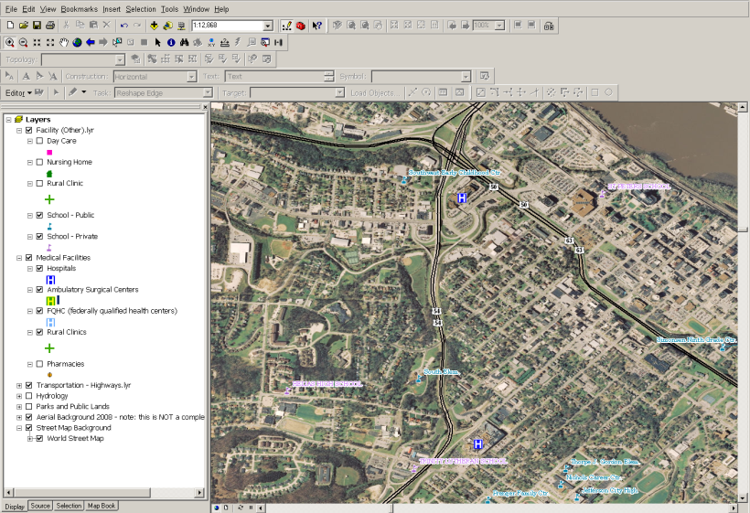


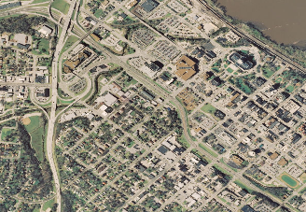
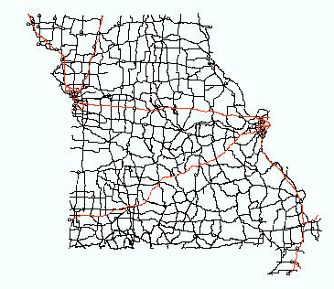

What is GIS?
Geographic Information System
GIS specializes in combining data from multiple sources and displaying that data in a geographic context.
Tables and databases
Data Feeds
Field Collection
Aerial photography
Geographic files
Notes:
Databases and other electronic files are combined with map layers to display data by geographic location. As long as there is some data describing location (e.g. county name, city name, address) within the file, it can be incorporated into a GIS project. It’s been estimated that 80% of data contains some sort of location.

Slide 5
What can you do with GIS?
Map where things are
Analyze data based by location
Find data densities
Provides a ‘picture’ of your data
Integrate this functionality into your business processes
Notes:
The most basic use of GIS is to make maps. You know the location of some feature and you just need a map showing where it is. If that’s all you needed, it true you could just do this using standard graphics software. But the true strength of GIS compared to graphic software, lies with its ability to analyze and display data. Instead of a graphic element that you can color, manipulate and print, you make changes to the underlying database. This is turn drives the changes on the map.
The real strength of a GIS is the set of analytical tools that it also contains. They include tools to locate and analyze features based on their physical proximity to other features, find ‘hot spots’ in your data and identify features that are within or near other feature. After all this analysis is done, the final output might still be a basic map. It doesn’t have to be fancy, some of the most basic maps are still very effective illustrations.

Slide 6
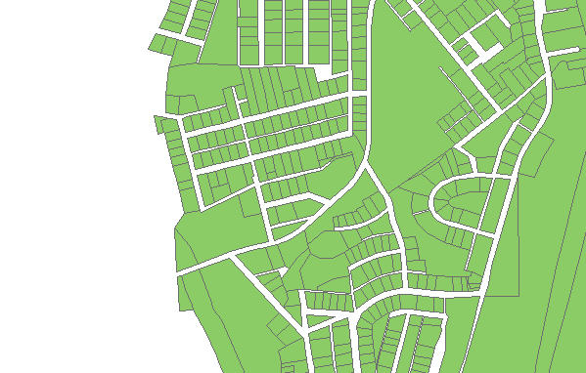

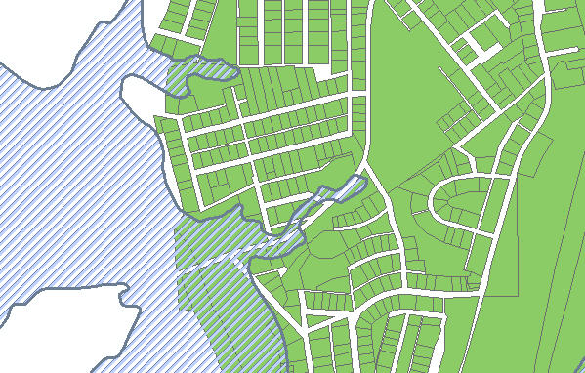
Analyzing Data by Location Floodplain and Property Boundaries
Property boundaries from tax assessor
Flood plain from FEMA
Combining data from two different sources, the properties that fall within the flood plain are now easily identified.
Notes:
Today, much of the information we use for analysis is already available in a GIS file format. A fair amount of time of every GIS project includes identifying the source for the data you need to perform the analysis. To determine which properties fall within a floodplain, data from two different sources was needed. Data from different sources may or may not contain any columns of common information.
Property boundaries are maintained by the County Assessor, while flood plain boundaries are defined by FEMA. Because these layers physically overlay each other, tools within the software can easily select which properties fall within the floodplain.

Slide 7
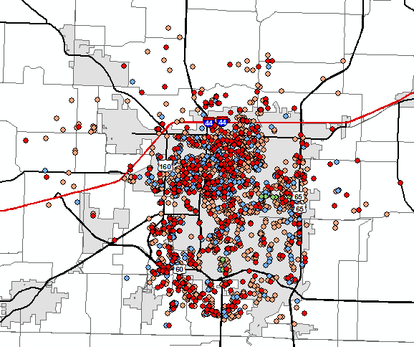
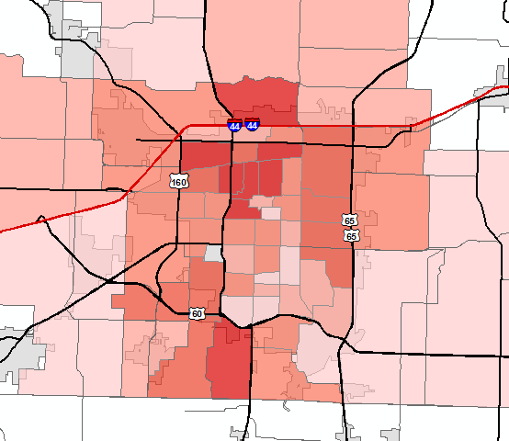
Data Summarization
Summarizing points by location, provides another way of illustrating the concentration of points.
Notes:
A map of points can be useful. A map of hundreds of points is less useful. This is a map of various crimes reported in a city. Using GIS, the points can be summarized by census tract or some other neighborhood boundary. The darker colors indicate a higher concentration of points, i.e. higher incidents of crime. This data can be further analyzed to compare this layer with basic demographic information, such as vacant housing and poverty status.

Slide 8
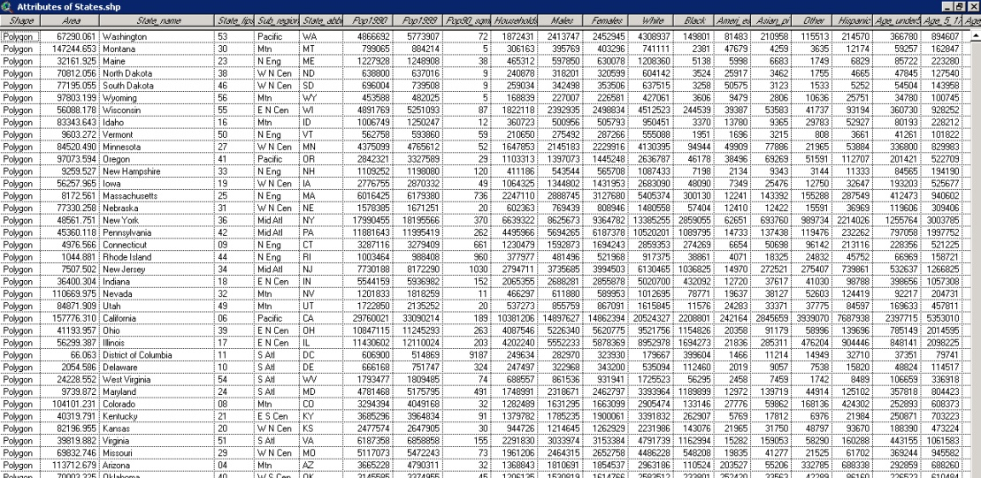
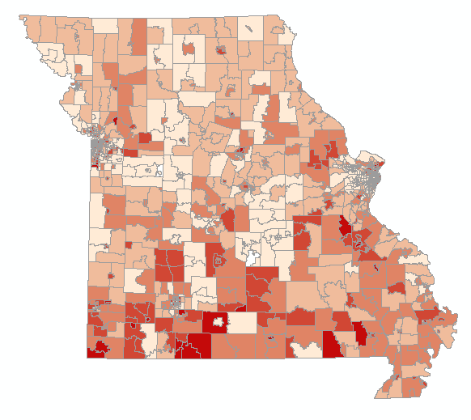
Provides a picture of your data
Data files are NOT easy to interpret!
The same data can be shown visually using GIS.
(A picture is worth a 1000 words.)
Notes:
We are all very visual in our society. Everyone is comfortable with pictures and will gravitate toward an illustration well before they read a paragraph of fine print. Some people use charts or graphs in an attempt to provide a visual for their data. Those visuals are helpful, but don’t show a good representation of how these records relate to each other spatially. In a table, we have a tendency to sort our data alphabetically, but the counties in Missouri do not start with Adair in the Northwest and end with Wright in the boot heel.
Although research analysts and statisticians can interpret lists and columns of figures, the general public cannot derive much information from a stream of numbers.

Slide 9
GIS Concepts
Layers
Place by address - Geocoding
Display tabular data on a map - Joining
Find what’s nearby - Buffering
Analysis and Output

Slide 10
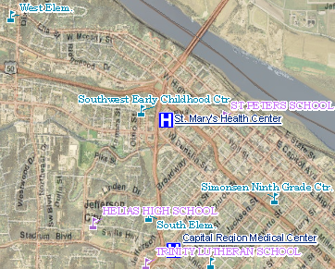
GIS Uses Data in Layers
Each feature is stored separately in its own layer, for example imagery, streets, hospitals or schools.
Each layer has an underlying database, which stores information about each feature.
Notes:
A key concept you should learn about GIS is that it is comprised of layers, which come from a variety of sources. Each GIS project has unique combination of layers specific to what you are trying to map or analyze. If you are looking at population trends, you may have a layer of population demographics from the US Census Bureau. If you’re looking at medical facilities or schools, you would have a separate layer for each of those features.
Each layer stores the graphic shape of each feature (known as geometry) but also information (known as attributes) about that feature. For example, the hospital layer contains attributes such as facility name, address, the total number of beds, and whether or not it is designated as a trauma center.

Slide 11
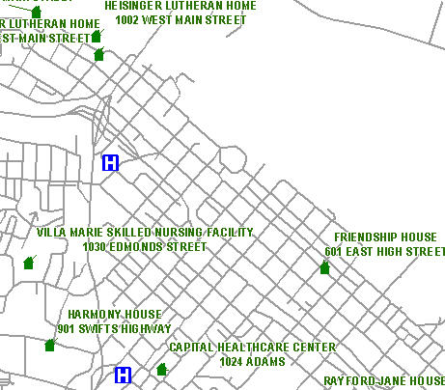
Geocoding
Tables of addresses are placed on the map based on their address. This technique is called geocoding.
Name | Address | City | State | ZIP | Phone | FAX | Type
Tracy Schloss | 301 W High St | Jefferson City | MO | 65109 | 573-522-5654 | 573-751-6140 | GIS
Notes:
An address is the most common method of describing a geographic location. Addresses are processed through a technique called geocoding, converting a table or list of addresses to a GIS layer you can display on a map. There are multiple vendors currently in use for geocoding. Geocoding may or may not be done within a GIS environment. It can be done transactionally, at the point of data entry within an application, or it can be processed in a batch mode. In transactional geocoding, the input address is passed to the geocoding software, where it is standardized to US Postal standards and returned to the calling application. Typically the user gets a chance to review the standardized address that is returned and is asked to validate. (This step is necessary because not all input addresses are complete are valid.) It’s not possible to geocode all addresses, a return rate of 90% or higher is considered good. Incomplete addresses, abbreviated street names, missing directional prefixes and private street names are all reasons why an address might not geocode. If the application does not allow the original input address to be replaced with a standardized one, best practice is to store the standardized address in a separate set of columns. The latitude and longitude should be stored in separate columns. If the geocoding software used returns a location quality code, this should also be stored. A location quality code indicates whether the returned address found is a street level match or only the center of a ZIP code.

Slide 12
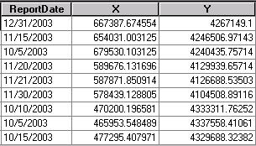
Tables – XY coordinates
Columns of X and Y coordinates are read directly from a table and generated as points
Common source either data collected in the field with a GPS unit, or generated from geocoding software
Notes:
Columns of coordinates can be loaded into a GIS project without any file conversion. The resulting layer is known as an event layer. Event layers are graphic representations of the tabular coordinates. As additional coordinate pairs are added to the table (frequently created and maintained in Access) points are added dynamically to the screen. Event layers always represent point data. A variety of database formats are support using either OLE or OBDC connections. The latitude/longitude columns of a geocoded table are a common example of this type of input.

Slide 13
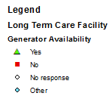
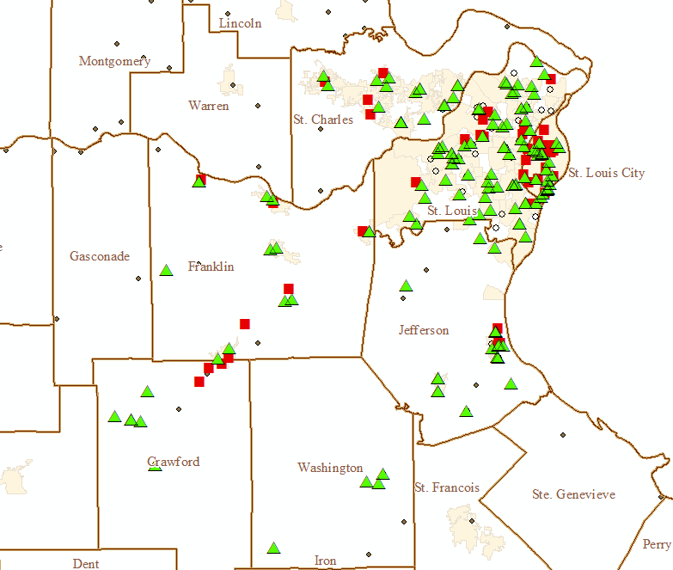
Symbolizing Data
Notes:
GIS features do not store symbology (i.e. shape, color, size) for their features. Users define their own preferences to each layer within a GIS project.

Slide 14
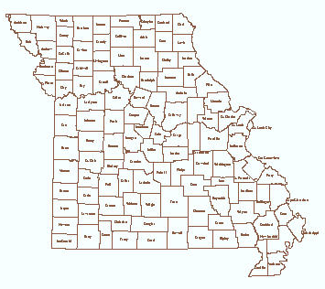
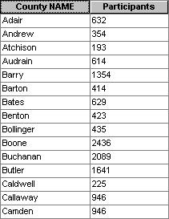

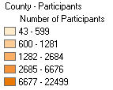
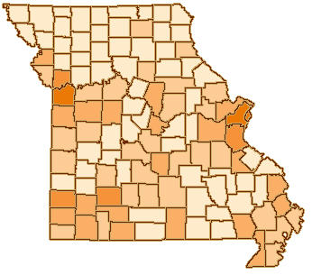
Joining Data
County GIS layer
Data by county
Data linked to boundaries
Notes:
Since we have GIS layers of counties, ZIP codes, districts, etc it is possible to link the tabular with the GIS layer via any common column of information. Several file formats are supported including OLE and OBDC connections to SQL Server, DB2 and Oracle. GIS staff can provide details on what types are compatible.

Slide 15
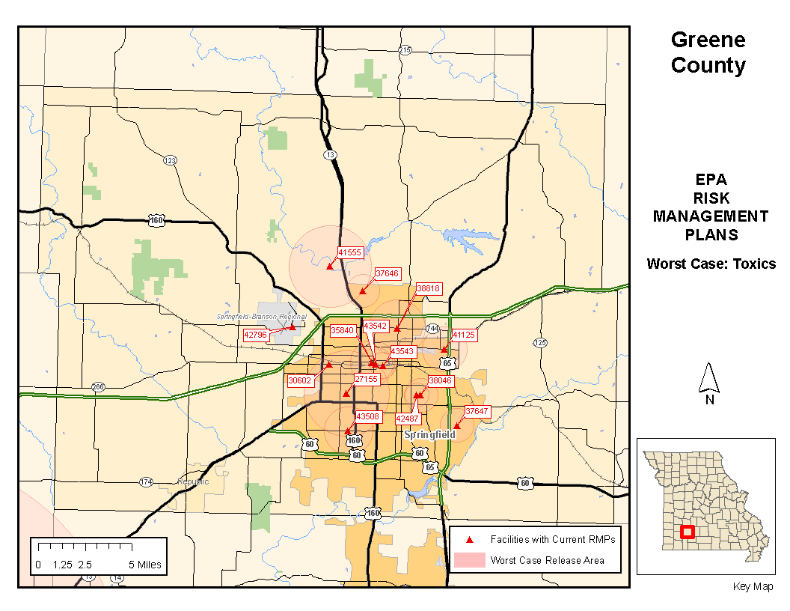
Buffering - Risk Management
Notes:
A combination of GIS data layers and an external database make up a typical GIS project. In this example, the facilities that store a variety of different chemicals are shown with a red triangle. The locations have a site ID which is linked to a database table which includes a distance that would be effected in the event of a chemical release. The distance is used to generate buffers, which have different distances depending on the type of chemical. These are shown as pink circles. These buffer layers are overlaid with layers of at risk population sites, such as day cares, schools and nursing homes.

Slide 16
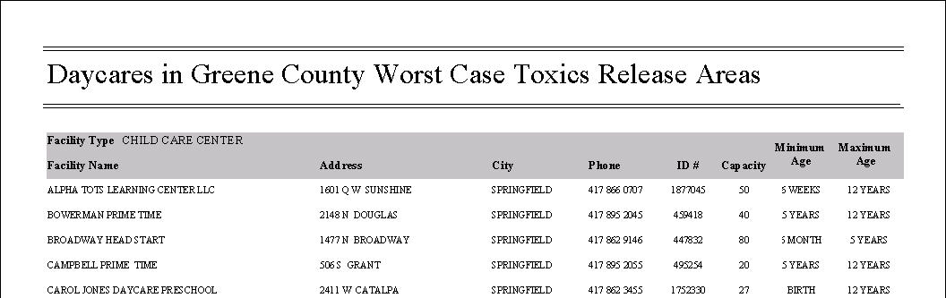
Output from the Analysis
GIS can create maps and reports
Standard output includes PDF format
Notes:
Once the overlay was finished, a report was created, listing out the facility, it’s chemical and which day cares would be effected in the event of a chemical release. A complete set of maps and reports were created for each county and provided to all the local health agencies.

Slide 17
Considerations
Not all data is GIS ready
Specific data types
Graphics intensive
Large storage requirements
Dependencies on services
Versioned editing
Notes:
GIS is dependent on properly structured data. There are a wide variety of formats that can be used, it’s the way the data is formatted that is the key to seamlessly integrating a dataset into GIS. The GIS file formats are designed to store both the graphics and data information for a feature. Graphic storage, as well as imagery (think aerial photography for the whole state) require larger than typical amounts of data storage. 20 years ago, GIS was already dealing with terabytes of data.
Sometimes data is offered not as a connection to a database, but in the form of a map service, a form of a web service. Map services allow data to be published and consumed by a variety of users and applications, without directly exposing the underlying database.
Versioned editing allows a managed approach to multiple users simultaneously contributing to the edits of a single database table.

Slide 18
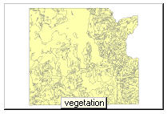
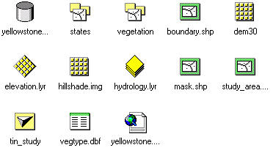
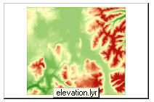
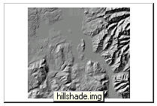
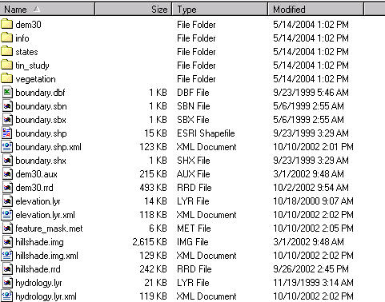
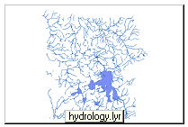
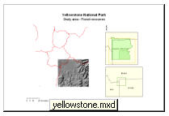
Supported file formats
Notes:
A wide variety of geographic data types as well as database formats are supported within a GIS. Some file formats aren’t a single file, but exist as a set of files. ArcGIS includes something called ArcCatalog, which allows the user to preview the content, both as a graphic view as well as in tabular form.

Slide 19
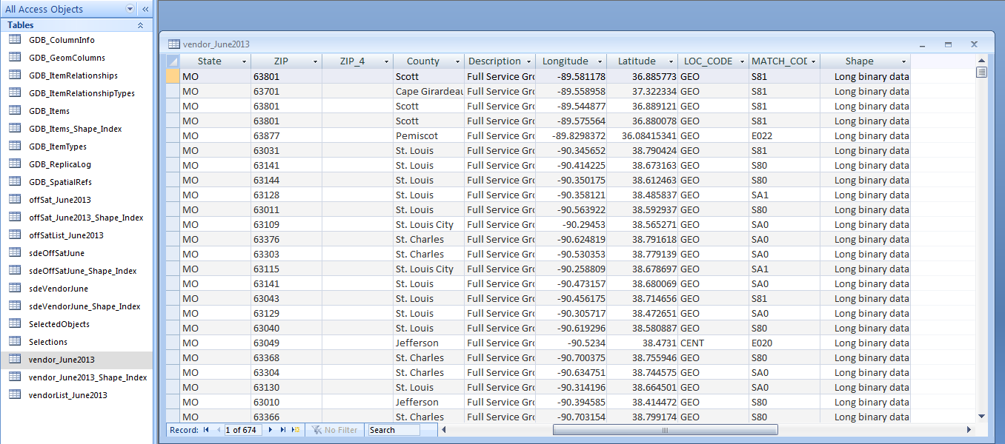
GIS data storage
other
feature
business
index
other
index
database
shape
In geographic formats, a set of files are used to store the data..
In order to maintain the integrity of geographic data, all file manipulation (e.g. copy, rename, delete) must be done from within the GIS software environment.
Notes:
There are multiple types of GIS file formats and each has its usage. Some are more portable, others are more efficient for a large number of records. Geographic data has in common generally 3 components: geometry, attributes and indices. Geometry stores the coordinate pair or pairs that creates the graphic display on the screen. Enterprise geodatabases are built on industry standard databases such as Oracle, Oracle Spatial, DB2 or SQL Server. The underlying enterprise database of choice varies agency by agency, depending on what RDBMS is used for their business applications
The GIS software maintains the relationship between the shape field (the geometry) with the rest of the information relating to each record (its attributes) using a series of indices. Manipulating the data records outside a GIS environment can easily result in a corrupted database.

Slide 20
Versioned editing
Function of enterprise geodatabases
Multiple users check out and edit the same file
Database replication – disconnected editing
Post and reconciliation process
Notes:
There are several options for having multiple edits contribute to a database layer. Versions of the layer can be created for individual users. Sections of the database can be replicated for users to work disconnected from the enterprise. Both methods require a data posting and reconciliation process with the default database.

Slide 21
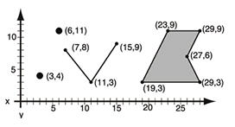
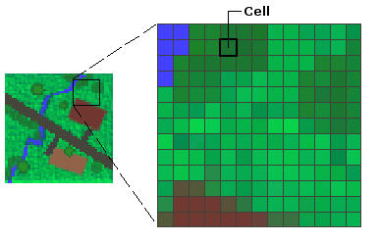
Basic Geographic Data Types
Vector
Point – Single XY pair
Line – Coordinate pairs that define a line
Polygon –Coordinate pairs that define a closed shape
Basic image format. The data is stored in a matrix or grid of cells
Raster
Notes:
Besides the standard field types, GIS data formats must accommodate the corresponding geometry for the 4 types of geographic data. BLOBs or OLE Object field types are often used to store the geometry.
Data is divided into two categories: vector and raster.
Vector data models are useful for representing and storing discrete features such as buildings, roads, or property boundaries. Each vertex of a feature is stored within the shape field.
Raster data models are useful for representing and storing continuous features such as aerial photography, elevation or terrain or for storing scanned documents. Examples of raster formats include TIFF, JPEG and BMP. Raster data is stored in rows and columns and there is only one value assigned for each cell. As the standards for aerial image quality go up, the amount of storage required to store this level of detail goes up. 20 years ago, 1 meter resolution was common (1 pixel = 1 meter on the ground). As computer processors and storage increases in capacity, its common to see 1 pixel = 6 inches, or even 3”.

Slide 22
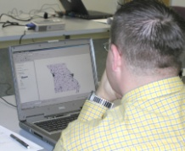

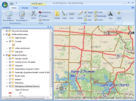


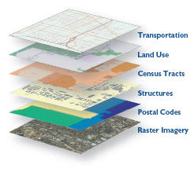
GIS usage
Desktop Viewers
*
Web mapping
Desktop Users
End Users
Customized Desktop Tools – VB.NET
C#
Python
ArcReader
ArcExplorer
*
ArcGIS - Basic
ArcGIS Online,
Customized web maps
GIS Server
ArcGIS Servers
GIS and Business Data
Business Databases - Oracle, SQL Server, DB2
GIS Data – Oracle, SQL Server, DB2
*
Most users
Notes:
GIS is available on the desktop, on the web and on mobile devices. Mobile and web GIS are generally customized to deliver a specific set of data and tools. Traditional desktop software is available in both free versions that have basic functionality and purchased software that includes many more tools and features. Like other applications, GIS has both a server and a data component to it.

Slide 23
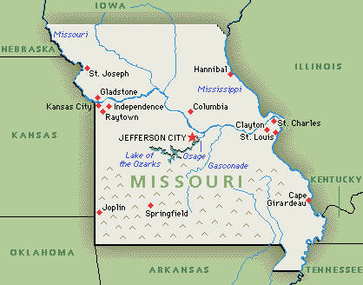
OGI Products and Services
Map cartography
Interactive web maps
GIS integration into a business process
Data and System Design
Notes:
OGI provides GIS services ranging from a very basic printed map to assistance with system and data design for integrating GIS functionality into business applications. If you’re not sure where GIS integrates into a business workflow, a meeting with OGI can help you identify how GIS fits in.

Slide 24
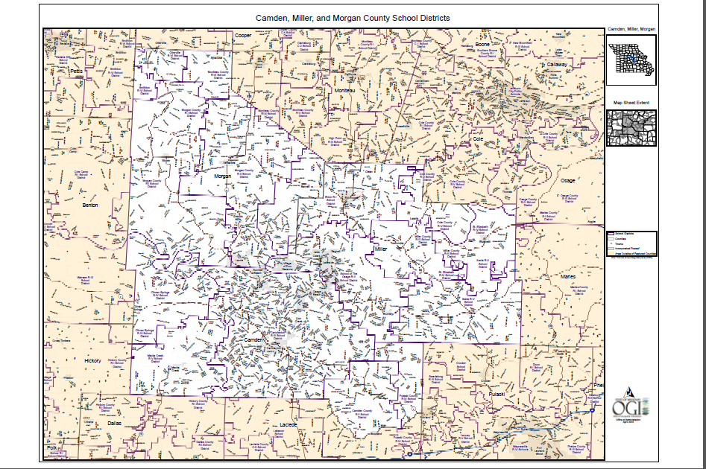
Notes:
Basic printed maps are a frequently requested product from OGI. The office has a large format plotter to print maps up to 42” wide.

Slide 25
ArcGIS Server
Map Services - Publishing GIS data and geoprocessing
Data source for customized web applications
Can also be consumed by ArcGIS desktop users
Notes:
Data and functionality published as an ArcGIS Service is available in a variety of output formats. The symbology and data associated with the features is determined at the time of publication. Map services are selected an combined in a customized interactive web application similarly to how data layers are combined in a desktop project.

Slide 26
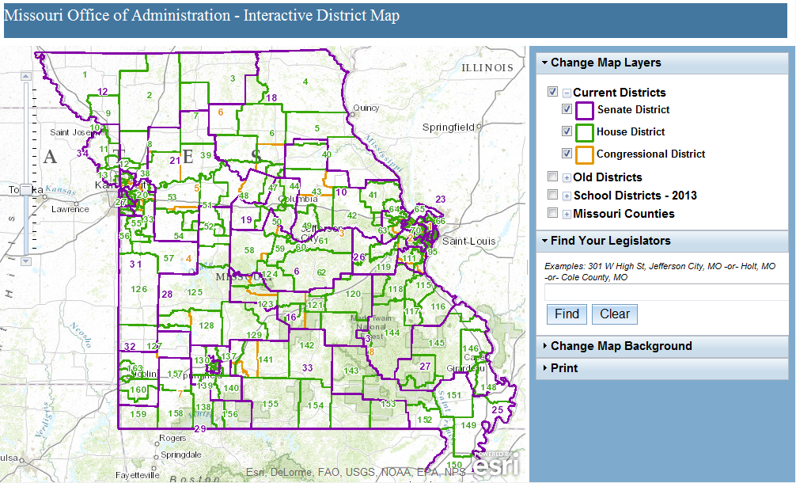
Interactive Web Maps
Missouri Legislative Districts
Web API libraries for JavaScript, Silverlight or FLEX
Notes:
When agencies need a web map featuring a particular data set with a custom set of tools to interact with that data, a web map using one of the web API libraries is created. The maps have traditionally been styled to work on the desktop, but mobile friendly web maps have also been created. There are several mobile SDK available that will work with our existing technology, although we haven’t yet created any apps with them.

Slide 27
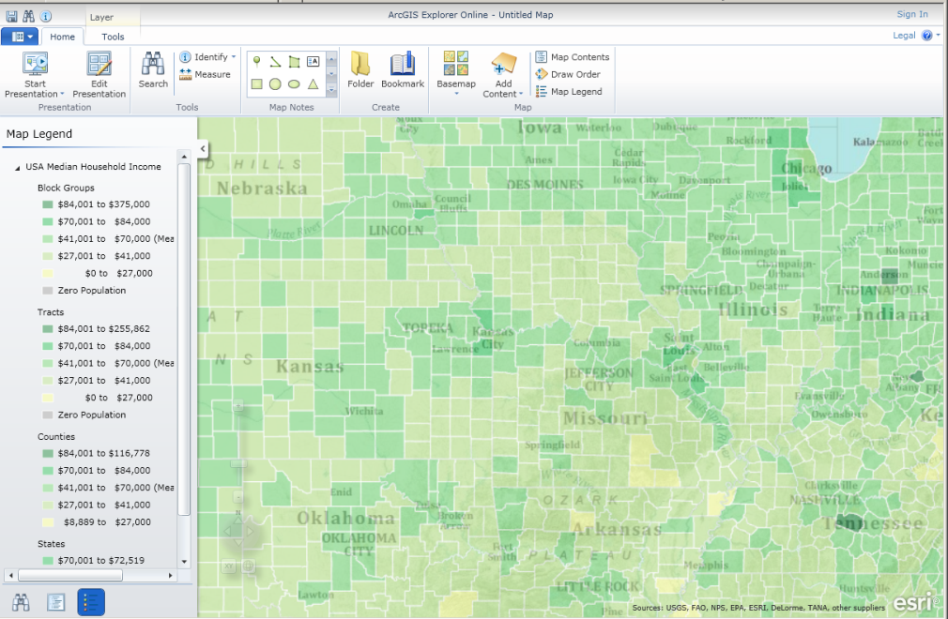
ArcGIS Online
ArcGIS Online is a cloud based solution for publishing maps online
Set number of authors, credits available
Fast and easy deployment
Notes:
The state has a limited number of users that can be authorized to post maps on the ArcGIS.com web site. Those authorized users will be managed through the OGI account. Additional authors and credits could be purchased. The site allows the user to quickly combine our locally hosted GIS data in the form of map services with cloud hosted base maps. Publically available map services from other sites can also be added. This interface has a very short learning curve and there are a variety of templates that are available for different types of maps. With the out of the box solution, you are limited to a small number of tools, and by what you can modify on the interface. If you need a higher level of customization, it can be developed and hosted on the OGI servers instead.

Slide 28
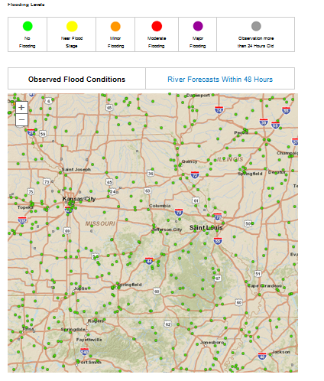
Embed web maps into a page
Web maps created through ArcOnline can be embedded into existing web pages with just a few lines of code.
<iframe width="760" height="730" frameborder="0" scrolling="no" marginheight="0" marginwidth="0" src="http://www.arcgis.com/home/webmap/embedViewer.html?webmap=5a9165da530145459910a7ab78291c4f&amp;zoom=true"></iframe>

Slide 29
Desktop GIS software
ArcGIS Basic is the standard GIS software
Licensed either as single or concurrent use
Data is of limited use without GIS software
GIS data generally stored on a separate server
Notes:
The standard GIS software used in the state is ArcGIS. The software can be license as single use, one license purchased per use, or concurrent use, a pool of licenses are made available to a group of users. The user must have access to the network in order to check out a concurrent use license, so they are not suitable for all circumstances. More users can be served with fewer concurrent use licenses, but the cost and annual maintenance for concurrent use licenses is higher.

Slide 30
ArcGIS – Levels of Functionality
Basic Desktop
Standard Desktop
Advanced Desktop
=
=
Interactive mapping
Map design and layout
Map-based query tools
Geoprocessing tools
Customizable application
Basic
Basic
+
+
Geodatabase administration
Geodatabase editing
Standard
+
Additional geoprocessing tools
$
Basic functionality
$$
Advanced functionality
$$$
ArcGIS is the umbrella term used to describe the entire product suite.
All products contain both ArcCatalog and ArcMap.
Additional tools are offered as you move up the product line
Notes:
ArcGIS Basic Desktop was formerly known as ArcView; the product line has had some name changes. ArcGIS has 3 levels of functionality – Basic, Standard and Advanced. There are hundreds of ArcGIS Desktop users throughout the state. Most installations are ArcGIS Desktop – Basic. The higher levels of functionality in Standard and Advanced are generally only useful to advanced users.

Slide 31
Desktop Environment
Data in a shared repository
Project layers are a series of links to data
Some multi-user data formats, others one at a time

Slide 32
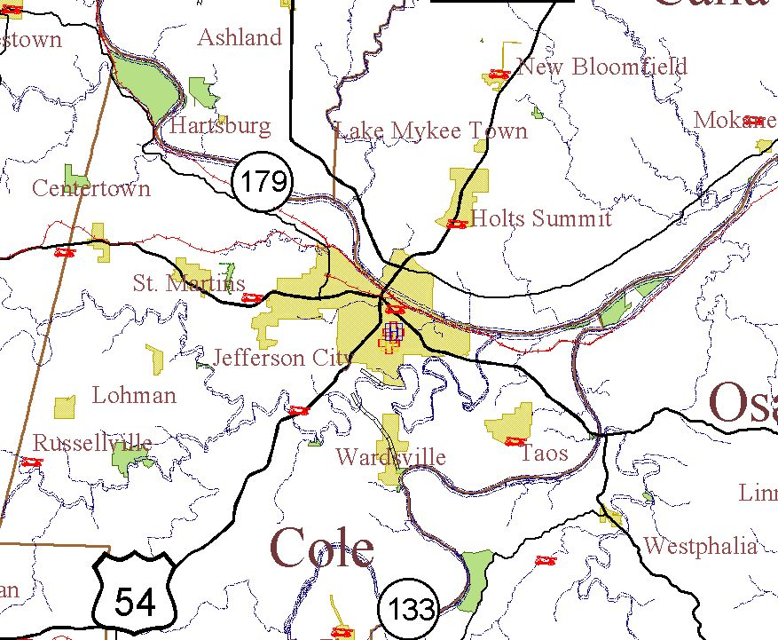
ArcGIS example
Notes:
The ArcGIS components ArcCatalog and ArcMap are demonstrated.

Slide 33
Integrating GIS into Business Process
With proper pre-planning, GIS can be integrated into a business workflow.
Retro-fitting GIS into existing applications can be tricky, but possible
Adding a GIS component may require programming, changes to the database structure, or both.
Notes:
Since many business applications contain some location information, many agencies would like to add GIS functionality to them. Ideally GIS sits “along side” or “on top of” these applications, tapping into the same databases that are used for the applications. Unfortunately, most data and applications was not designed specifically to work with GIS. A review of current applications and databases will be necessary to determine what needs to be done to incorporate GIS into the workflow. Geographic files are in a specific format unique to GIS applications, so standard databases can’t be simply adjusted to ‘have GIS’.

Slide 34

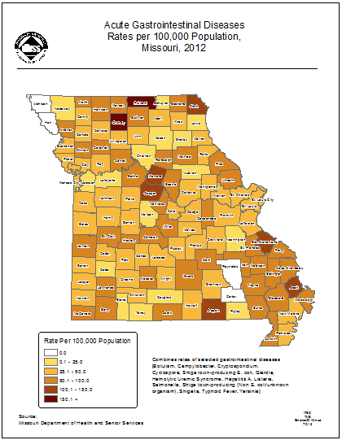

Types of Integration
Non-GIS
Data
GIS software
Paper Map
Non-integrated GIS and data
Notes:
In a non-integrated GIS environment, GIS is not connected to your business data. It is extracted out of a database or maintained in some non-database file (Excel, text). The data is likely to need formatting and cleanup to be used with GIS software. This approach can be suitable for a one-time map. For maps that need to be updated frequently or available in anything but paper, this largely manual process requires a lot of man hours to maintain.

Slide 35
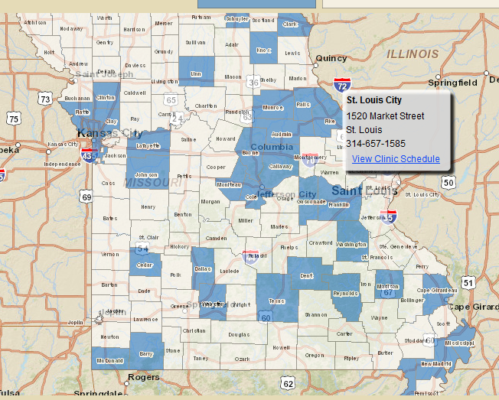
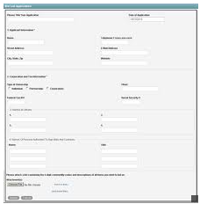
Types of Integration
Business
Database
+
GIS Data
Business Application
Interactive Web Map
Dynamic business data, GIS data is static
Notes:
One form of integration is to have a business application populate a database which is designed to join with a GIS layer. In this example, county health departments post their scheduled flu clinics through an APEX application. The underlying database has a view that contains only the data relevant to the web map. It is joined to the GIS data layer for county boundaries. Counties shaded in blue indicate counties that have posted their flu clinic schedule. The web map updates dynamically as the counties register their flu clinics.

Slide 36
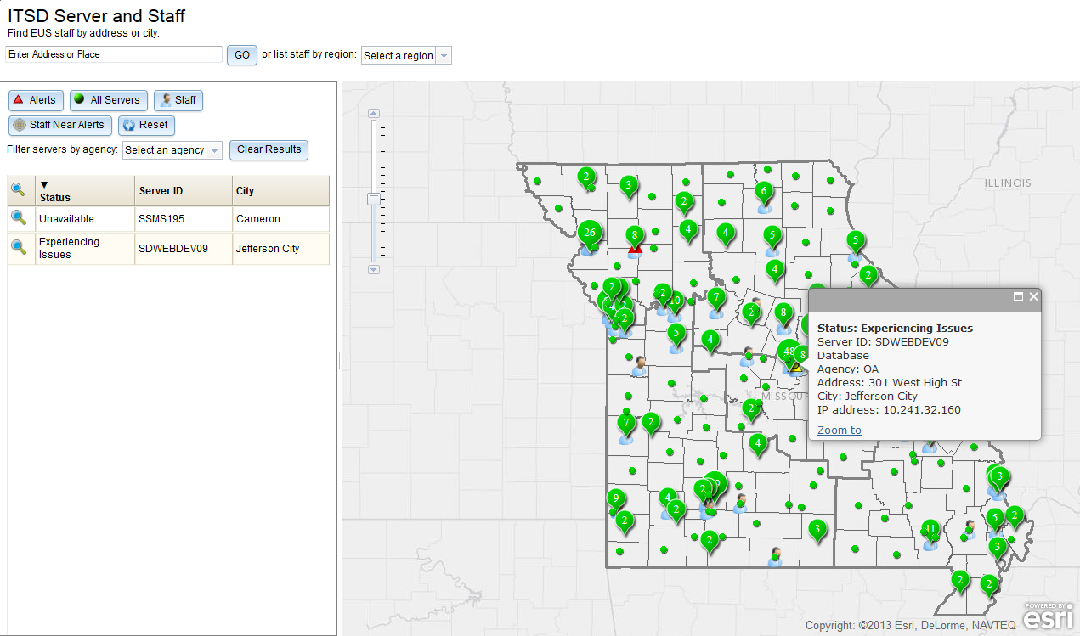
CMDB – Map Interface
Notes:
The Configuration Management Database (CMDB) used by the state data center (SDC) includes information on servers and staff including current alerts. Servers are shown in green. Where servers are clustered, the number of servers are shown in an information tag. Alerts of Unavailable, Experiencing Issues and Maintenance are overlaid, along with the location of EUS staff. The interface will easily let you determine which staff are nearest to any alert.

Slide 37

Types of Integration
GIS
Database
Paper Map
Users trained in GIS
GIS software
Dynamic GIS data
Notes:
When GIS is fully integrated into an application, a combination of GIS data and business data is combined. Business processes may rely heavily on GIS data. Those agencies has users that are trained in how to use the ArcGIS Desktop software to perform data updates. The underlying database changes are available to many other users, and might also be used as a data source for a dynamic web map.

Slide 38
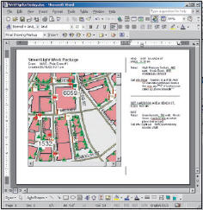
Streamline GIS processes
Desktop customization
GUI modification
Custom components in .NET or Java
Python scripting
Notes:
Part of an integrated GIS system is to review the current workflow, looking for repetitive processes. Out of the box ArcGIS Basic Desktop contains hundreds of tools. When the same GIS steps are executed routinely by multiple users, it makes sense to streamline their workflow by creating a custom interface and/or custom tools. Although custom components can be written in .NET or Java, the more common process is to develop a custom script, or set of scripts, using Python.

Slide 39
Types of Integration
GIS
Database
Users trained in GIS
GIS software editing
Business
Database
Dynamic GIS and dynamic business data – designed to fully integrate
Notes:
When GIS is fully integrated into the business workflow, edits occur both within GIS and business applications. In this integrated design, GIS passes data to business application, and vice versa. Integrated environment provide a data platform for dynamic, real time products.

Slide 40

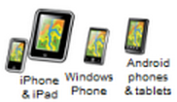
Enterprise GIS Example
GIS
OGI
Mapper
WebEOC
Online Editors
GIS
SEMA
GEE
Google
Fusion
GIS
CERT
GE Portable
Image
Server
Data Feeds
OGI SQL Server
Database
Online Viewers
GIS
National
Guard
ArcGIS
Online
Non-GIS
Data
Notes:
As GIS becomes more tightly integrated into an enterprise, data and information from all different types of sources is collected, consumed, integrated, viewed and redistributed in the form of many different GIS products – from desktop to online to mobile.

Slide 41
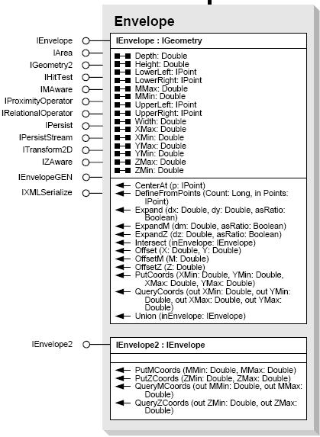
ArcGIS SDK and API – Components for GIS
Components not found in a typical business application
Variety of platforms supported
Geometry
Display
Layers
Spatial Reference
Navigation
Notes:
The unique aspects of geographic analysis require specialized objects not available in a standard component library. There are objects for both managing geometry, spatial references (how the sphere of the earth is projected onto a 2D plane), data types (points, lines, polygons) and symbology (color, outline, font, line style). SDK and APIs are available for a variety of platforms, both desktop and mobile devices.

Slide 42
Contact Information
Email: MO.GIS@oa.mo.gov
ITSD-GIS web page:
http://content.oa.mo.gov/information-technology-itsd/it-governance/office-geospatial-information/
Thank you for your interest in GIS.

