Slide 1



2021 Show Me Excellence Summit
October 19, 2021
ENTERPRISE RISK MANAGEMENT
2021 Show Me Excellence Summit ∙ Achieving Excellence Together

Slide 2

Is risk management on your radar?
Is risk management part of the dialogue with your executive teams?
Do you evaluate risks to achieving strategic goals when deciding initiatives?
Do you have a team member(s) responsible for risk management in your agency?
2021 Show Me Excellence Summit ∙ Achieving Excellence Together

Slide 3
Use Enterprise Risk Management (ERM)
to achieve your strategic goals
ERM is a Risk management framework designed to integrate risk management throughout the enterprise
Proactive risk management starts with strategic goals
Identify and quantify risks
Prioritize risks that have the biggest impact to the organization
Develop treatment plans to address risks
2021 Show Me Excellence Summit ∙ Achieving Excellence Together

Slide 4
Traditional risk management versus
Enterprise Risk Management
Traditional Definition
of Risk
Traditional Definition
of Risk Management
Broadened Definition
of Risk
The possibility that something bad or unpleasant will happen.
Merriam-Webster
Minimizing the adverse effects of accidental losses.
The Institutes
The effect of uncertainty on objectives.
ISO 31000
2021 Show Me Excellence Summit ∙ Achieving Excellence Together

Slide 5
Compare traditional risk management
to ERM
Traditional Risk Management
Minimize adverse effect of accidental losses
Risk office led
Reactive, sporadic
Silos, segmented
Often measured by financial impact
Enterprise Risk Management
Effect of uncertainty on objectives
Agency led
Proactive
Holistic, enterprise wide
Integrated into existing practices, culture
Measures financial and non-financial impact/exposure
2021 Show Me Excellence Summit ∙ Achieving Excellence Together

Slide 6
ERM is an industry best practice
Clearly state the goal
Identify risks to reaching the goal
Rank risks by likelihood and impact
Leadership review and approval
Share
results
Develop Risk Register & Treatment Plans
Prioritize the risks
Measure success
Implement Treatment Plans
Enterprise Risk Management Cycle
2021 Show Me Excellence Summit ∙ Achieving Excellence Together

Slide 7
Seven Steps to ERM
State the goal
Identify risks
Analyze the risks
Prioritize
Treatment plan
Risk register
Communicate
2021 Show Me Excellence Summit ∙ Achieving Excellence Together

Slide 8
ERM roles and responsibilities
Executive Team
Lead ERM efforts, ensure accountability of risk owners
Review, approve priorities and risk treatment plans
Implement ERM into management cycle
  Accountability and authority to manage risk
  Highest level of subject matter expert
  Assemble work teams, develop treatment plans
  Communicate and report; Monitor and evaluate
Risk Owners
Subject Matter Experts
Technical expert in specific areas of risk
OA Risk Management
Provide risk management tools
Provide resources and guidance in ERM
2021 Show Me Excellence Summit ∙ Achieving Excellence Together

Slide 9
ERM should be integrated into existing
business processes
Not new function
Incorporated into:
  Strategic Planning
  Quality Improvement
  Budgeting
  Employee Engagement
  Committee Structure
  Decision-Making
2021 Show Me Excellence Summit ∙ Achieving Excellence Together

Slide 10
ERM can help achieve strategic priorities
ASPIRATION
We will accelerate change across the state government
with superior services and support
THEMES
(ERM Strategic Priority/Goals Step 1)
Deliver the right stuff at the right price and at the right time
Use data and analytics to improve decision-making and transparency
Build the State of Missouri workforce for the future
Partner to innovate the way we work
Enterprise Risk Management
Identify risks to achieving goal (ERM step 2)
Evaluate each risk (ERM step 3)
Map and prioritize risks based on severity and likelihood (ERM step 4)
INITIATIVES
(ERM Risk Treatment Plans Step 5)
2021 Show Me Excellence Summit ∙ Achieving Excellence Together

Slide 11
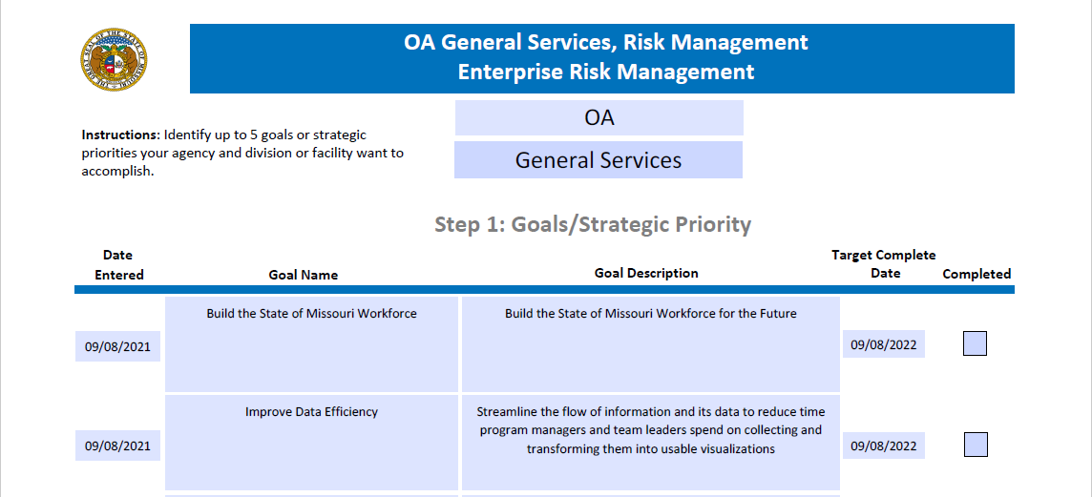
STEP 1: Clearly State the Goal
Strategic objective or different organizational goal
Strong leadership support is critical to success
2021 Show Me Excellence Summit ∙ Achieving Excellence Together

Slide 12
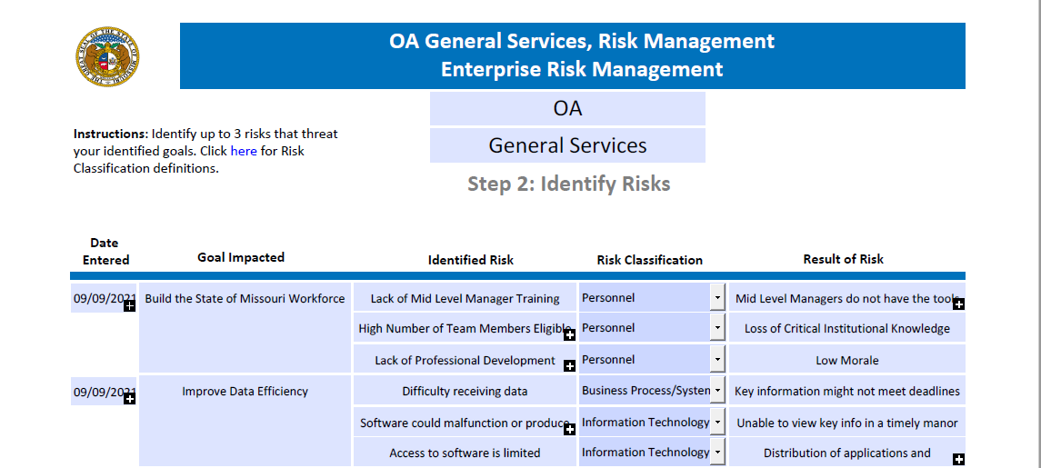
STEP 2: List everything that could prevent
you from meeting your goal (the risks)
2021 Show Me Excellence Summit ∙ Achieving Excellence Together

Slide 13
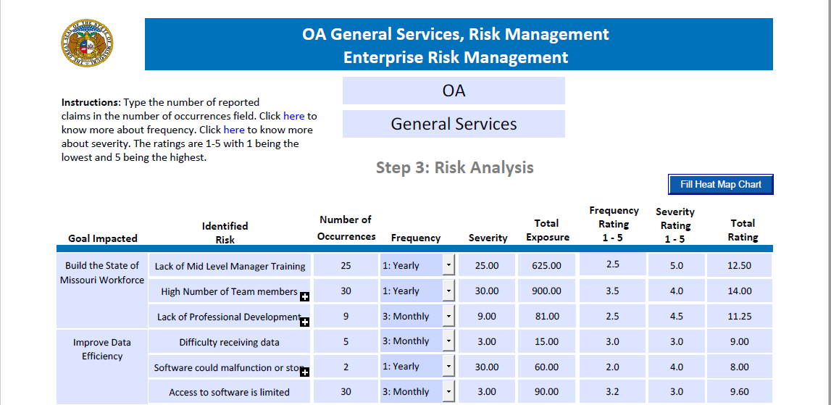
STEP 3: Evaluate each risk by ranking
likelihood and impact
2021 Show Me Excellence Summit ∙ Achieving Excellence Together

Slide 14
STEP 4: Prioritize the risks
Risk Likelihood | 5–Almost Certain Normally occurs at least annually
 | 4–Likely Likely to occur in next 3 years
 | 3–Possible May occur every 10 years |  |  | Access to Software is Limited | High Number of Team Members Eligible to Retire
 | 2–Unlikely Unlikely in foreseeable future |  |  |  | Software Could Malfunction or Produce Errors Lack of Professional Development Through the Enterprise | Lack of Mid Level Manager Training
 | 1–Rare Has occurred, but is rare
 |  | 1–Insignificant No measurable impact on the Department | 2–Minor Impact on the Department will last only for days | 3–Moderate Impact on the Department may last for weeks | 4–Significant Impact on the Department may last for months | 5–Critical Impact on the Department may last for years
Organizational Impact
2021 Show Me Excellence Summit ∙ Achieving Excellence Together

Slide 15
ERM can help achieve strategic priorities
ASPIRATION
We will accelerate change across the state government
with superior services and support
THEMES
(ERM Strategic Priority/Goals Step 1)
Deliver the right stuff at the right price and at the right time
Use data and analytics to improve decision-making and transparency
Build the State of Missouri workforce for the future
Partner to innovate the way we work
Enterprise Risk Management
Identify risks to achieving goal (ERM step 2)
Evaluate each risk (ERM step 3)
Map and prioritize risks based on severity and likelihood (ERM step 4)
INITIATIVES
(ERM Risk Treatment Plans Step 5)
Implement statewide succession planning
2021 Show Me Excellence Summit ∙ Achieving Excellence Together

Slide 16
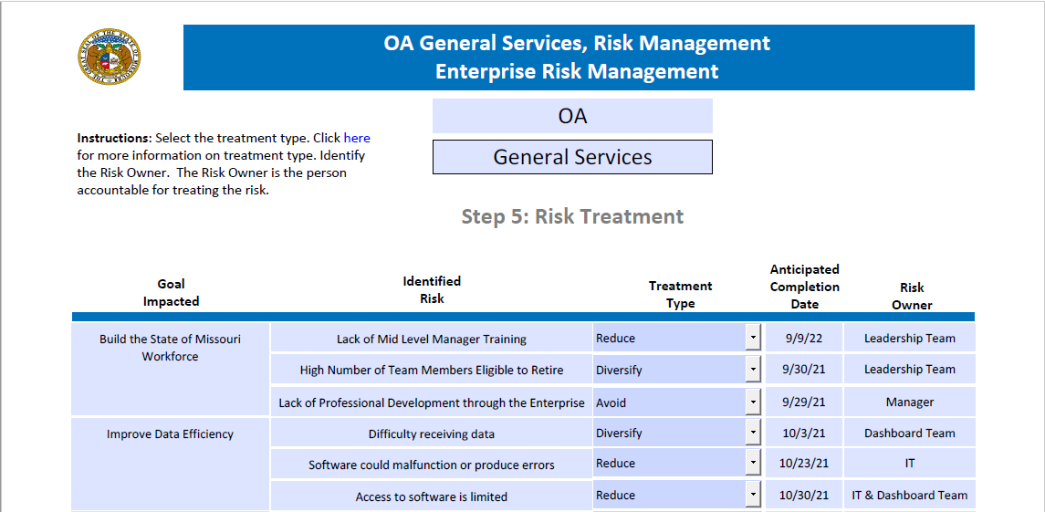
STEP 5: Treat/mitigate the risks
Risk treatment plans are action steps to address risks
2021 Show Me Excellence Summit ∙ Achieving Excellence Together

Slide 17
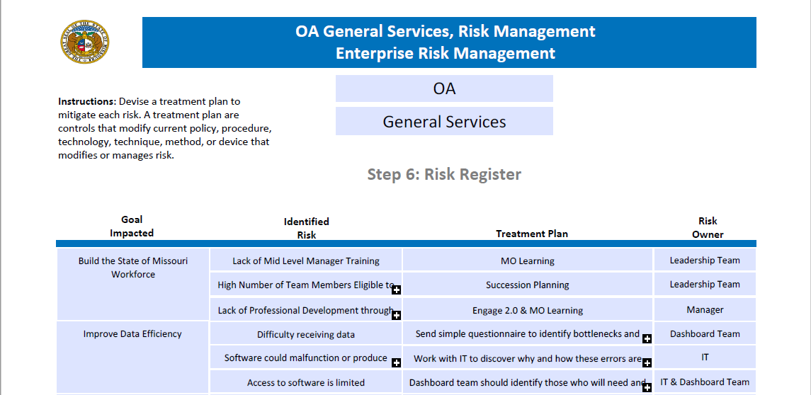
STEP 6: Risk Register
Risk registers include treatment plans and measures of success
2021 Show Me Excellence Summit ∙ Achieving Excellence Together

Slide 18
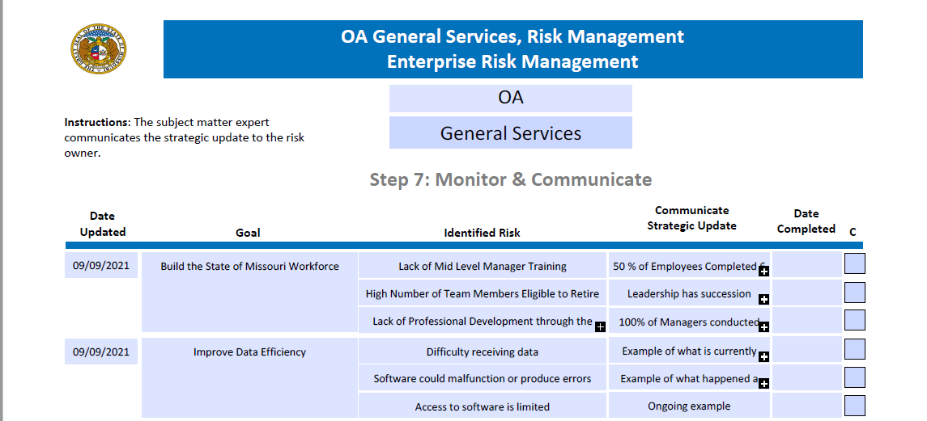
Step 7: Monitor & Communicate
Risk owners regularly update leadership team
2021 Show Me Excellence Summit ∙ Achieving Excellence Together

Slide 19
ERM template walk through
OA Risk Management
https://oa.mo.gov/general-services/risk-management
2021 Show Me Excellence Summit ∙ Achieving Excellence Together

Slide 20
Proactive risk management will help
you achieve your goals
Clearly state the goal
Identify risks to reaching the goal
Rank risks by likelihood and impact
Leadership review and approval
Share
results
Develop Risk Register & Treatment Plans
Prioritize the risks
Measure success
Implement Treatment Plans
Enterprise Risk Management Cycle
2021 Show Me Excellence Summit ∙ Achieving Excellence Together

Slide 21
Risk Management is here to help
Office of Administration, Division of General Services
    Cindy Dixon, Director and Director, Operational Excellence
    Jacinda Thudium, Deputy Director and State Risk Manager
    Grayson Imhoff, Safety & Loss Control Specialist
    https://oa.mo.gov/general-services/risk-management
2021 Show Me Excellence Summit ∙ Achieving Excellence Together

Slide 22
Session Survey
2021 Show Me Excellence Summit ∙ Achieving Excellence Together

