Slide 1

CARS
Carpool Automated
Reservation System
https://www.cars.oa.mo.gov
User’s Guide
(updated 7/1/12)

Slide 2
OA Carpool Contact Information
Email: oa.carpool@oa.mo.gov
Phone: 751-4534
Contacts:
  Michelle McCarty 751-4534
  Cindy Dixon 526-1988
After Business Hours: contact information is in the vehicle packets

Slide 3
CARS System Overview
Driver profiles for each carpool user that will store basic information about the driver including name, SAM II agency and organization code, email address, contact info, default billing information, and default pool location.
Drivers will be able to store ‘common trips’ if they routinely take the same trip for the same purpose, same destination, etc..
Email confirmations can be sent to the driver, scheduler or both
Drivers will be able to view their schedule, submit change requests, or delete scheduled requests
View and print projected trip cost data based on the trip criteria entered on the request. This analysis will assist drivers in making the most cost effective travel decisions by comparing the projected cost of the OA carpool, contract rental and mileage reimbursement
The CARS system will have an automated interface between SAM II HR and the State Fleet Information System driver’s database to ensure that OA carpool drivers are active state employees and have a valid driver’s license
The CARS system will use active directory for userids and passwords so you will not need to remember another id and password. Your active directory id is your domain name\userid that you use to sign into Windows.

Slide 4
OA Pool Locations
MSP (old Missouri State Penitentiary) – East Capital Avenue
Mental Health Central Office – East Elm Street
Corrections Central Office – Plaza Drive
Howerton Building – Howerton Court
Health & Senior Services – 920 Wildwood
Knipp Drive – 3418 Knipp
Truman Building, Room 760
Agriculture, 1616 Missouri Blvd.
Vehicle Maintenance, 705 Mo Blvd (Box Truck Only)
Lewis & Clark State Office Building, 1101 Riverside Drive (opening 5/1/12)

Slide 5
System Access
To use the CARS system, an employee must:
  Be active in SAM II HR
  Have an Active Directory account with an email address
Each employee that wants to check out a carpool vehicle must be set up as a driver in the CARS system

Slide 6
System Security Levels
Driver
Drivers can establish their own profile without going through an agency security coordinator
Create/edit/delete their own trips
Scheduler
Create/edit driver profiles and trips for employees in their agency
Security access granted by the OA Carpool Administrator – email oa.carpool@oa.mo.gov to request a change to your security setting
Create/edit their own profile

Slide 7
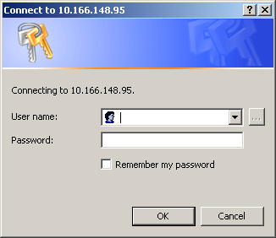
First Time Users
Go to the OA carpool website at: http://oa.mo.gov/gs/carpool.htm
Click on the Logon button
Enter your Windows domain name\userid in the userid field along with your Windows password, click OK.
You will then be directed to a one-time driver registration page

Slide 8
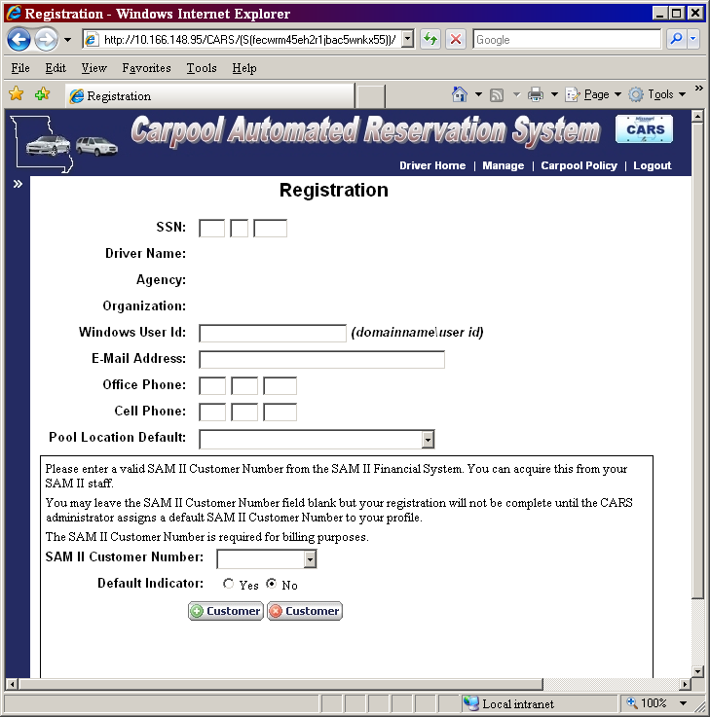
Driver Registration
One time registration to create your driver profile
All system users must first establish a driver profile (even if they are only going to schedule trips for other employees)
Driver profiles will store basic information about the driver including name, SAM II agency and organization code, email address, contact info, default billing information, preferences for pool locations, vehicle types, etc..

Slide 9
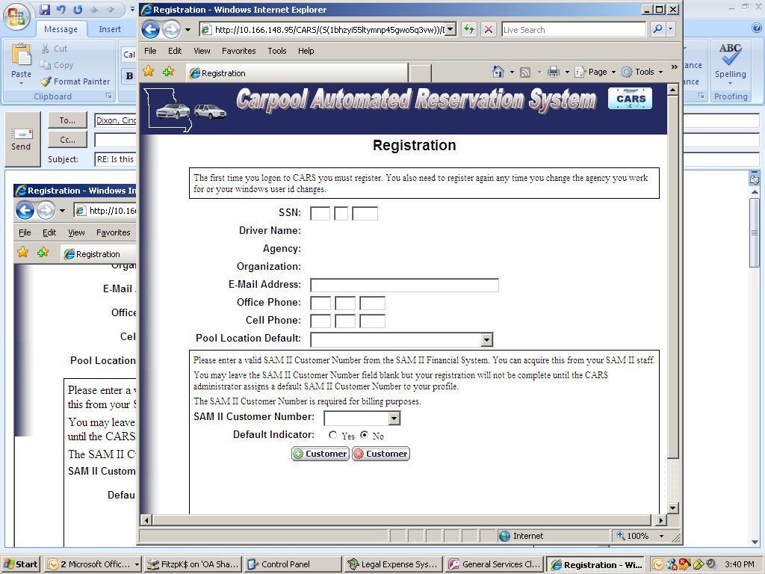
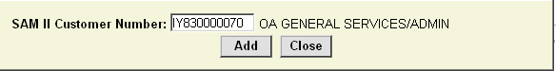
Driver Registration
Enter SSN
  Driver Name and Agency/Org will default from SAM II HR
Email Address will be pulled automatically from Active Directory
Enter phone numbers
Select a default pool location from the drop down list
Add 11 digit SAM II Customer Number(s) for billing purposes

Slide 10
Driver Registration
SAM II Customer Numbers
The OA Carpool system will interface with the SAM II Financial system to bill user agencies each month
Each driver profile must have a default SAM II customer number for billing purposes
If the driver does not know their customer number, their registration will not be complete until the OA Carpool Administrator assigns a default customer number to the profile
Drivers can add more than one customer number to their profile
Drivers can establish a default customer number for a specific trip by establishing a ‘common trip’

Slide 11
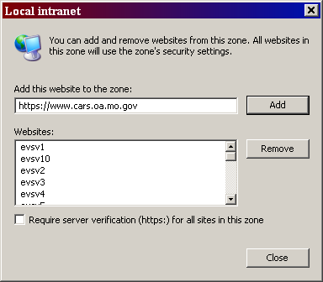
One Time Browser Setup to Skip CARS Logon Window
Open Internet Explorer
Go to:
  Tools
  Internet Options
  Security
  Local Intranet
  Sites
  Advanced
Enter CARS web address: https://www.cars.oa.mo.gov
  Click Add

Slide 12
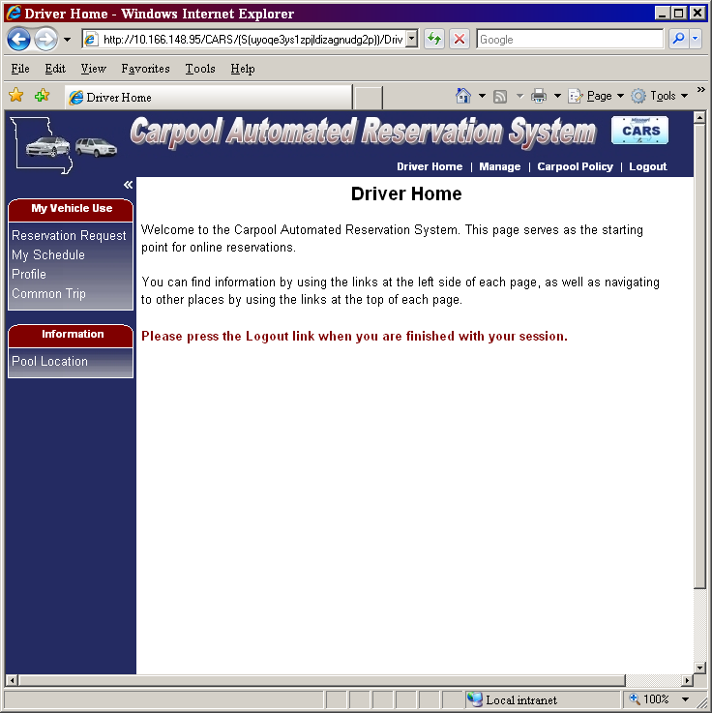
Driver Home Page
After a driver registration is complete, the driver will be taken to the ‘Driver Home’ page.
System Navigation
  The ‘My Vehicle Use’ section on the left side of the screen
  Pool Location Info on left side of screen
  Top of Screen – Driver Home, Policy, Logout

Slide 13
My Vehicle Use Sidebar
Reservation Request – create a new request
My Schedule – view a list of requests including those pending, confirmed or completed
Profile – update contact info, default pool location or customer number
Common Trip – add, view or edit common trips

Slide 14
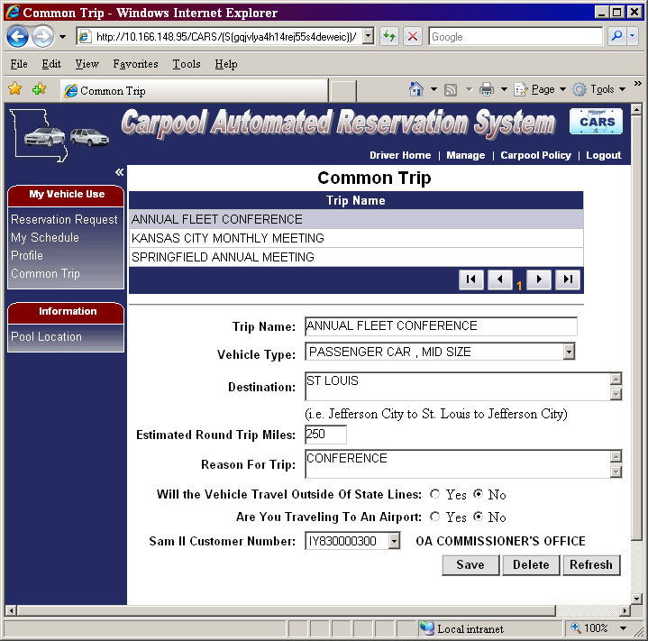
Common Trips
Common Trips reduce data entry if the employee takes the same trip (destination, purpose, miles, billing) repeatedly.
Select Common Trip from the My Vehicle Use Sidebar or on the Request Trip Tab
Common Trip data can be edited by typing over existing data and clicking the ‘Save’ button

Slide 15
Reservation Request

Slide 16
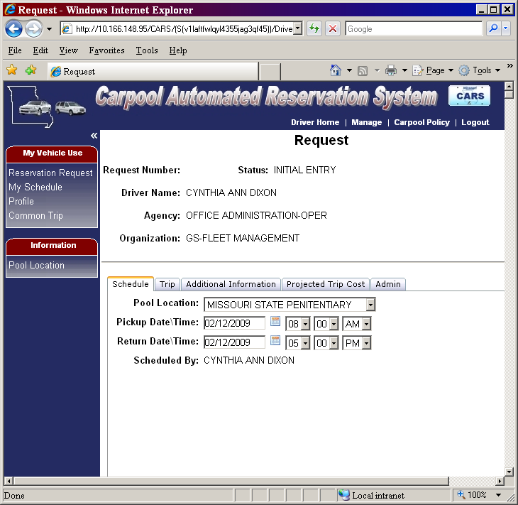
Reservation Request
To complete a request fill out information on the following tabs:
  Schedule
  Trip
  Additional Information
To view cost select the projected trip cost tab
Admin - OA Carpool use only - agencies can view certain fields on this tab

Slide 17
Reservation Request
Schedule Tab
Select
  Pool Location
  Pickup Date & Time
  Return Date & Time
  Click on the Trip tab to continue

Slide 18
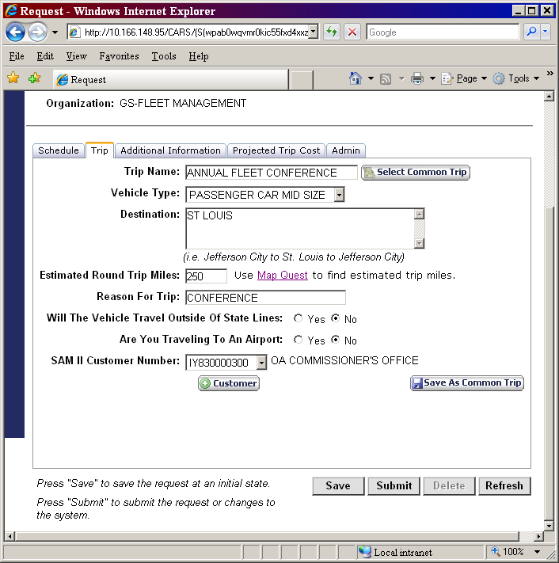
Reservation Request
Trip Tab
Select Common Trip if applicable OR complete all of the fields on the screen
To store this trip as a common trip click the ‘Save As Common Trip’ button at the bottom
  Click on the Additional Information tab to continue

Slide 19
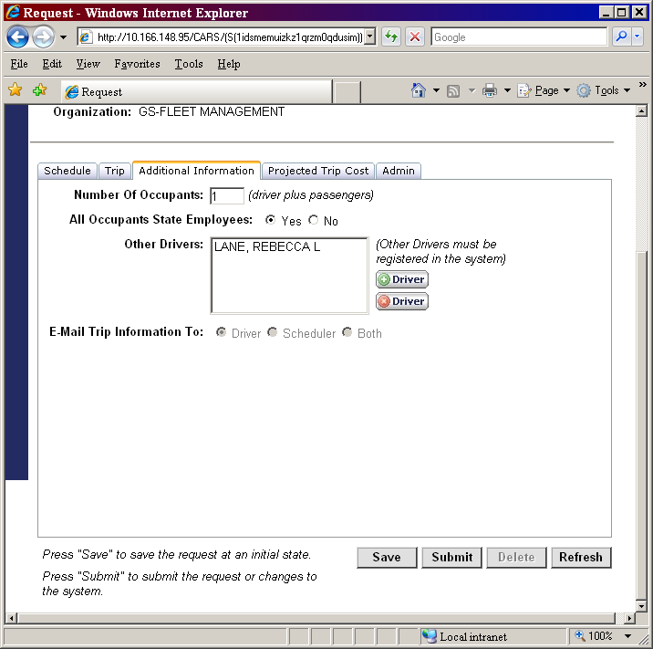
Reservation Request
Additional Information Tab
Complete:
  Number of Occupants
  All Occupants State Employees?
  Add other employees that may drive the vehicle (they must be registered in the CARS system to operate an OA carpool vehicle)

Slide 20
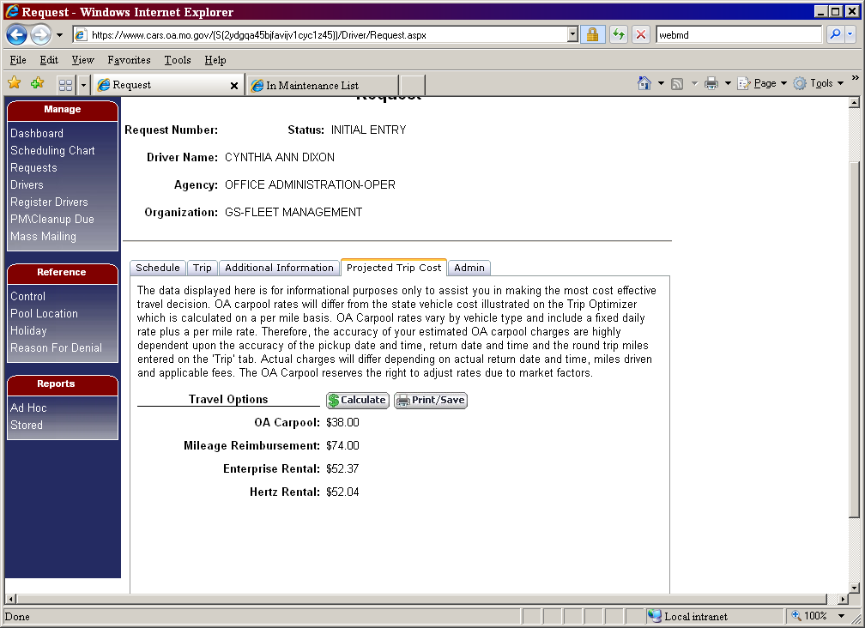
Projected Trip Cost
Click the Calculate button to view projected cost between OA Pool, mileage reimbursement and a rental vehicle
Based on trip parameters entered on the Trip tab
Print /Save option available – click print button and a PDF document will open in a separate window

Slide 21
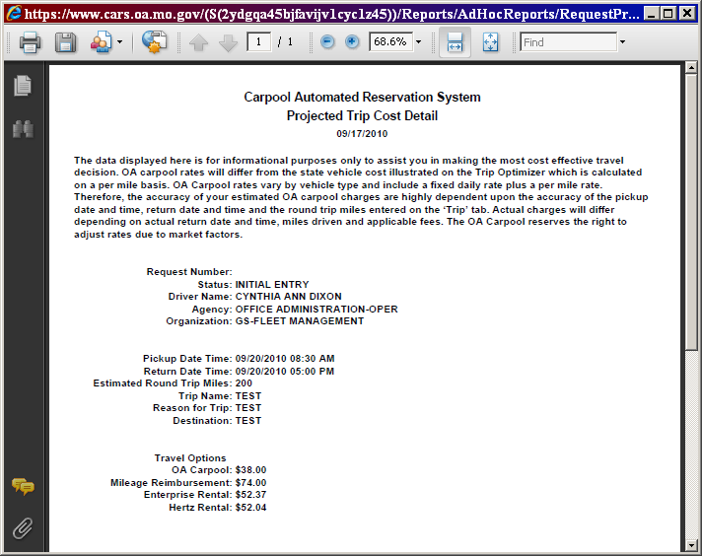
Print or Save Cost Detail Report

Slide 22
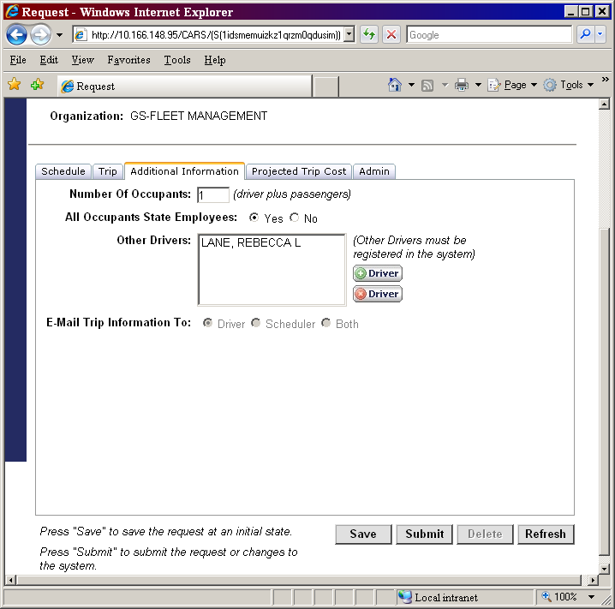
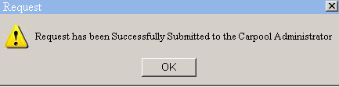
Save or Submit a Request
To SAVE, click the ‘Save’ button at the bottom of the screen.
To SUBMIT your request, click the submit button. If there are no errors, you will see the below message and a request number beginning with an ‘R’ will be assigned at the top of the screen

Slide 23
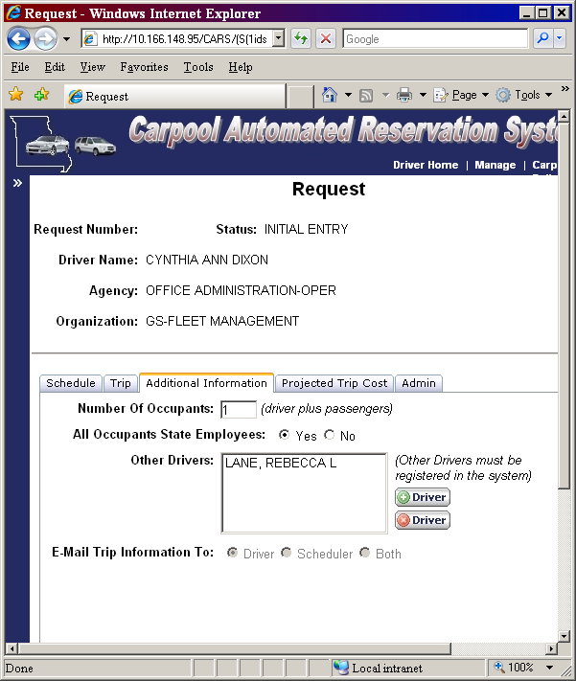
Request Status
The request status is displayed in the request header.
  INITIAL ENTRY
  PENDING RECOMMENDATION
  PENDING SCHEDULING
  SCHEDULED
  DISPATCHED
  RETURNED
  BILLING COMPLETE
  DENIED

Slide 24
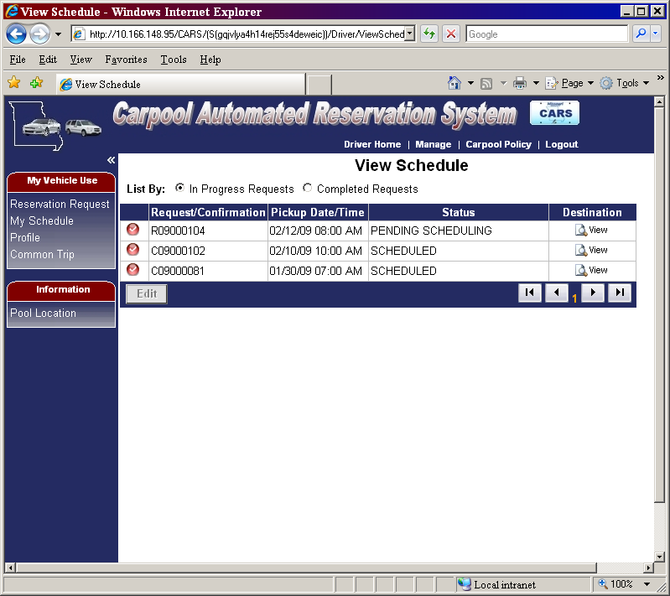
View Schedule
Select ‘My Schedule’ from the My Vehicle Use Sidebar
Select ‘In Progress’ or ‘Completed’ Requests
To edit an ‘In Progress request, click on the request and click the edit button.

Slide 25
How to Change a Request
Go to ‘My Schedule’
Select the Request and Click Edit
To delete – click delete at bottom of page
To change – modify the dates/times and click submit

Slide 26
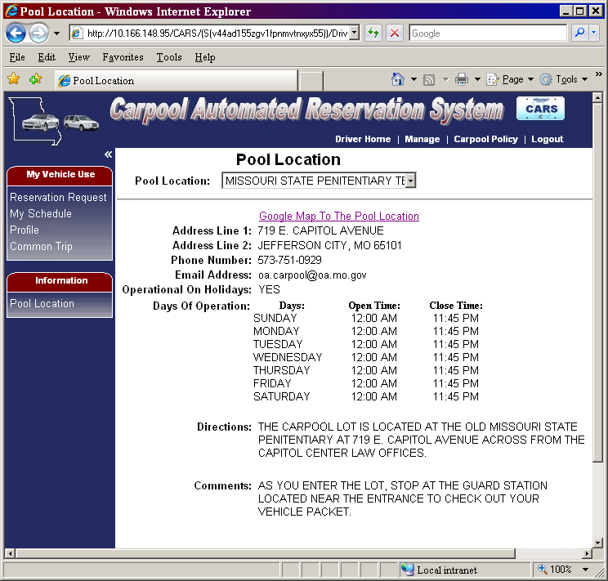
Pool Location Information
Get specific info on each pool location
Select a pool location at the top of the screen
View:
  Address
  Google map link
  Hours of operation
  Directions

Slide 27
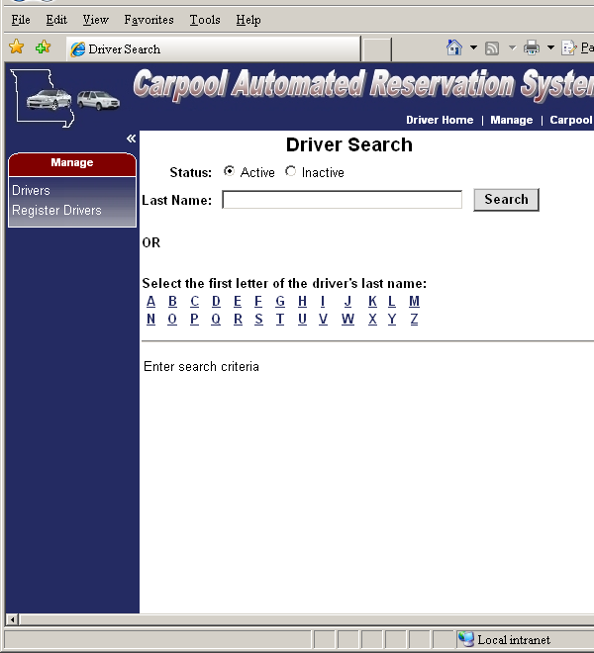
Scheduler Home Page
Schedulers will be taken to the Driver Search screen.
System Navigation
  The ‘Manage’ section on the left side of the screen has options to search for Drivers or register new drivers
  The top navigation links allow the scheduler to get to the Driver Home page

Slide 28
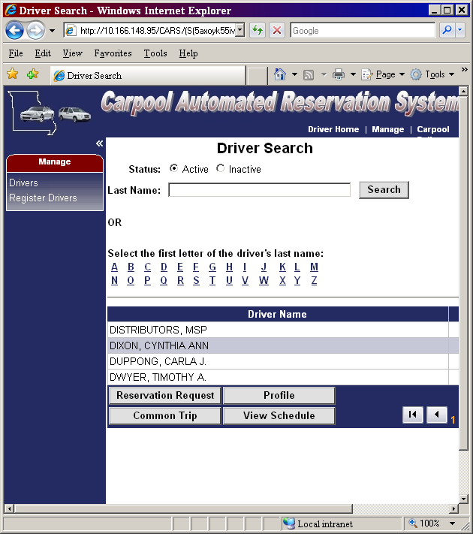
Scheduler Driver Search
Select the name from the results list by clicking on it
After you select a name, the circled buttons below are enabled.

Slide 29
Confirmation Email
-----Original Message-----
From: Carpool Automated Reservation System [mailto:oa.carpool@oa.mo.gov]
Sent: Monday, May 03, 2010 8:46 AM
To: Dixon, Cindy
Subject: Confirmation #C10005159 May 3
The below request is confirmed. The driver must print this email and take it along with a photo id to pick up the vehicle.
TRIP INFORMATION
Confirmation Number - C10005159
Driver - CYNTHIA ANN DIXON
Pickup Date and Time - Monday, May 03, 2010 at 9:00 AM
Return Date and Time - Monday, May 03, 2010 at 3:30 PM
Pool Location - MSP - E. CAPITOL AVENUE
Pool Location Address - 719 EAST CAPITOL AVENUE
Requested Vehicle Type - PASSENGER CAR MID SIZE
Scheduled Vehicle Type - PASSENGER CAR MID SIZE
The OA Carpool makes every attempt to accommodate your requested vehicle type. If your requested vehicle type is unavailable you will be scheduled for the next larger size vehicle.
DIRECTIONS
THE MSP CARPOOL LOT IS LOCATED AT THE OLD MISSOURI STATE PENITENTIARY AT 719 E. CAPITOL AVE ACROSS FROM THE CAPITOL CENTER LAW OFFICES. YOU WILL ENTER THE LOT THROUGH AN OPENING IN THE OLD PRISON WALL.
PICKUP PROCEDURE
STOP AT THE GUARD STATION LOCATED NEAR THE ENTRANCE AND GO INSIDE TO PICK UP THE PACKET.
For more detailed information on directions, pickup procedures and other general information go to http://oa.mo.gov/gs/carpool.htm.
Please adhere to your scheduled pickup and return times. If you will be late, please call 573-751-0929 as soon as possible.
HOW TO CHANGE OR CANCEL YOUR RESERVATION: You can change or cancel your reservation directly in the CARS system. Go to the 'My Schedule' screen, select the request or confirmation number and click the edit button. To change, edit the information and click the save button at the bottom of the screen. To cancel, click the delete button at the bottom of your screen.

Slide 30
Picking Up the Vehicle
Take the confirmation email with you to the carpool lot along with a photo id – pick up instructions are included on the email
The Dispatcher will locate your trip in the CARS system, print the trip ticket and give you the packet
At the same time the Dispatcher will check out the vehicle in CARS and the daily charges begin

Slide 31
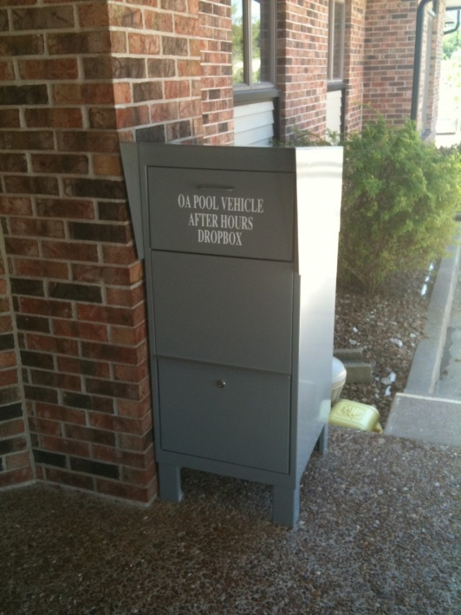
Returning the Vehicle
Return instructions included on confirmation email
Record ending odometer reading on the Trip Ticket
Notify us if the vehicle needs cleaned or has mechanical problems
Return the Trip Ticket and Packet to the Dispatcher (during business hours)
Use after hours drop box if applicable
After Hours Drop Box (available at all locations except MSP)

Slide 32
Rate Structure
  Fixed daily rate per vehicle type PLUS per mile rate
  Daily charges begin at actual pickup time and end at actual return time
  If Dispatcher selects ‘no’ for late return, charges end at the scheduled return time
  Standard Daily Rate = 24 hour day except last day of rental which includes an additional two hour grace period
  Reduced Rate = 4 hours or less, no grace period. If trip is greater than 4 hours, full standard rate is charged

Slide 33
FY 2013 Rates
Vehicle Type | Examples | Standard Daily Rate | Reduced Rate (4 hrs or less) | Per Mile Rate
Sedan – Compact | Ford Focus | $19.50 | $9.75 | 12 cents
Sedan – Mid | Fusion, Avenger | $21.00 | $10.50 | 14 cents
Sedan - Full | Impala | $23.00 | $11.50 | 16 cents
Station Wagon | Taurus Wagon | $21.00 | $10.50 | 17 cents
Minivan | Uplander, Caravan | $27.50 | $13.75 | 17 cents
Cargo Minivan | Caravan | $26.50 | $13.25 | 15 cents
SUV-Mid 4x4 | Explorer | $26.00 | $13.00 | 22 cents
Pickup-Quad Cab 4x4 | Dodge Ram | $23.50 | $11.75 | 26 cents
Box Truck |  | $39.00 | $19.50 | 42 cents

Slide 34
Late Returns
Late fees may be applied if more than one hour late past the scheduled return time
Exception: after hours drop off locations
Late Fee: $10.00
If you know you are going to be later than planned, please contact us so that we can adjust your reservation

Slide 35
Other Fees
No Show Fee: $20.00
  May be applied if you do not notify us to cancel the reservation
Cleaning Fee:
  May be applied if the vehicle is left in such condition that we cannot reasonably expect another person to use it prior to our regular cleanup
  Fee will equal our cost to clean the vehicle

Slide 36
Reminders
Return vehicles with at least ¾ tank of gas
Use E-85 fuel in flex-fuel vehicles when possible
Keep vehicles clean of trash
No personal use
No smoking

